Slide 1

CHAPTER 2
Sets, functions, sequences, sums

Slide 2


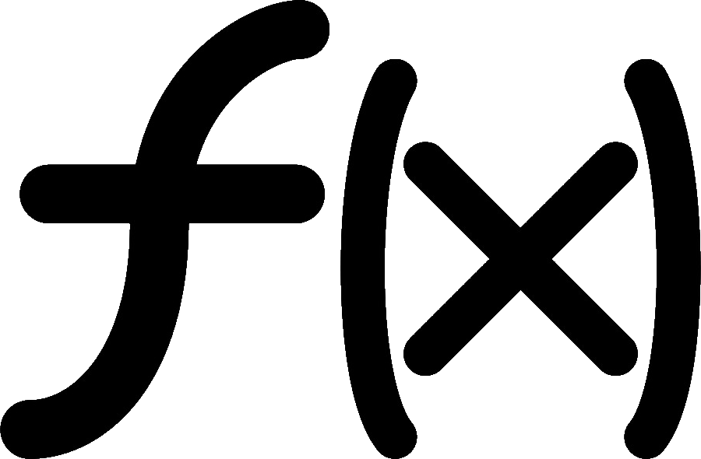

Why study this chapter?
Many important discrete structures are built using sets
graphs
relations
Functions
used to represent complexity of algorithms
needed for cryptography, machine learning
Sequences
Summations

Slide 3



Learning Objectives
Manipulate set operations
Represent sets by bit strings
Determine whether a rule is a function
Determine whether a function is 1-1, onto, bijective
Find composite functions
Find next terms, general term of a sequence
Express a sum as sigma notation

Slide 4
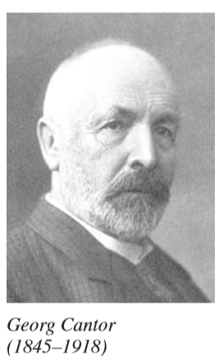
sets
A collection of objects, called elements/members
{a, b, {c} } is a set with 3 members a, b, and {c}
 denotes the set of natural numbers 0, 1, 2, 3, …
 is the of integers …, -2, -1, 0, 1, 2, …
 is the set of real numbers

Slide 5
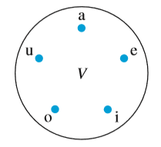
Venn diagrams
Venn diagram for the set of vowels
V = {a, e, i, o, u}

Slide 6
membership relation
a ∈ {a, b, {c}}
c ∉ {a, b, {c}}
a ∈ A means
a is an element/member of the set A
a is in A
a belongs to the set A

Slide 7

equality
Two sets are called equally if and only if they have the same elements
{1, 2, 3} = {2, 1, 3} = {1, 2, 3, 3}
{1, 2, 3} ≠ {2, 3, 4}
{a, b} ≠ {a, {b}}

Slide 8


empty set
The set with no elements
{x |x > 3 and x < 2 } = { } = ∅
∅ = {∅}
∅ ∈ {3}
{a, ∅} = {a}

Slide 9


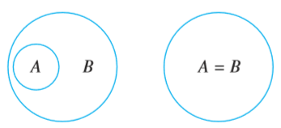
subset proper subset
B ⊆ A
⇔ ∀x(x∈B ⇒ x∈A)
B is called a subset of A,
e.g., {a, b} ⊆ {a, b, c}
Write B ⊂ A if
B ⊆ A, and B ≠ A
B is called a proper subset of A, e.g., {a, b} ⊂ {a, b, c}
{a, b, c} ⊆ {a, c, b}
{a, b, c} ⊂ {a, c, b}
B ⊆ A

Slide 10

properties
S
S
S
∅ ⊆ ∅
∅ ⊆ {a}
∅ ∈ {a}
∅ ∈ {a, ∅}
Proof.
∀x(x∈∅ ⇨ x∈S)
Proof.
∀x(x∈S ⇨ x∈S)
F ⇨ F
F ⇨ T
F ⇨ F
T ⇨ T

Slide 11

Set equality

Slide 12

power set
set S | subsets | power set P(S) | |P(S)|
∅ | ∅ | {∅} | 1
{1} | ∅, {1} | {∅, {1}} | 2
{1, 2} | ∅, {1}, {2}, {1, 2} | {∅, {1}, {2}, {1, 2}} | 4
{1, 2, 3} | ∅, {1}, {2}, {3}, {1, 2}, {1, 3}, {2, 3}, {1, 2, 3} | {∅, {1}, {2}, {3}, {1, 2}, {1, 3}, {2, 3}, {1, 2, 3}} | 8
2^{n}

Slide 13

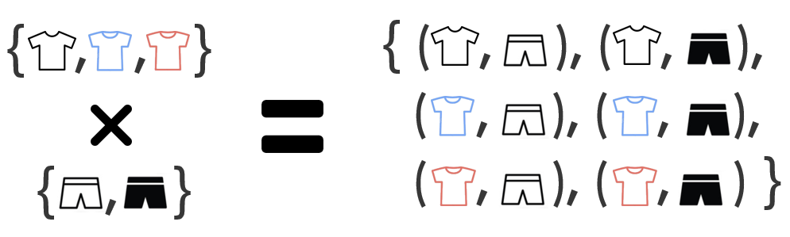
Cartesian product

Slide 14

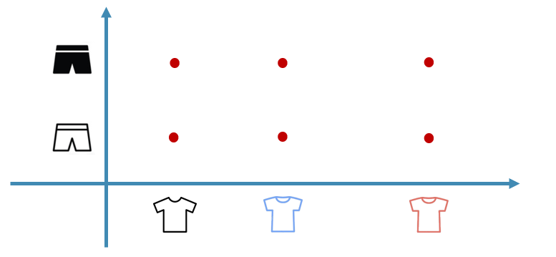

(a, b) ≠ (b, a)

Slide 15
Cartesian product
Given two sets A = {a, b, c}, and B = {1, 2, 3, 4}
How many elements does A×B have?
(3, a)∈ A×B
{b, 2} ∈ A×B
{(a, 1), (c, 3)} ⊆ A×B
A×B = B×A

Slide 16
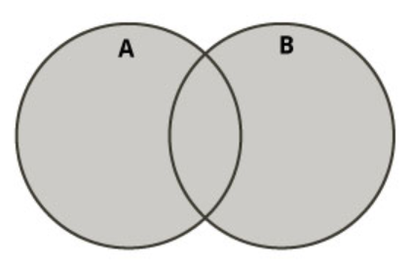
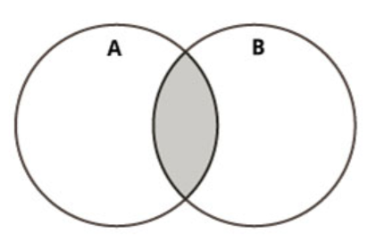
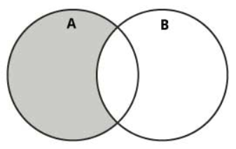
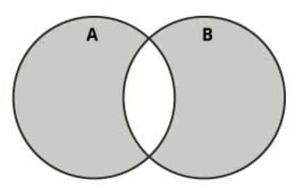
Set operations
A ∪ B
union
A ∩ B
intersection
A – B
difference
A ⊕ B
symmetric
difference

Slide 17
Universal set and complement
Universal set
U = {1, 2, 3, 4, 5, 6, 7, 8}
A = { 2, 5, 6, 8}
‾A = {1, 3, 4, , 7 }
A ∪‾A = U
A ∩‾A = ∅
complement of A

Slide 18
Computer representation of sets
U = { | 1, | 2, | 3, | 4, | 5, | 6, | 7, | 8 }
u[n] | 1 | 1 | 1 | 1 | 1 | 1 | 1 | 1
A = { |  | 2, | 3, |  | 5, |  | 7 | }
a[n] | 0 | 1 | 1 | 0 | 1 | 0 | 1 | 0
B = { | 1, | 2, |  | 4, | 5, |  |  | 8 }
b[n] | 1 | 1 | 0 | 1 | 1 | 0 | 0 | 1
What is the bit string for ‾A? A ∪ B? A ∩ B? A – B? A ⊕ B?

Slide 19

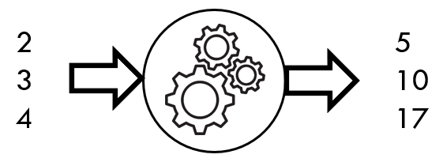
functions
⇨
⇨
Input | Output
2 | 5
3 | 10
4 | 17
Input
x
Output
y
•
•
f = {(2, 5), (3, 10), (4, 17)}
•
f(x) = x² + 1
x ∈ {2, 3, 4}

Slide 20
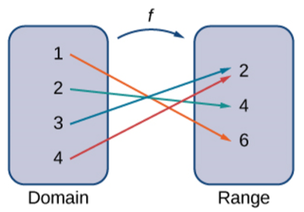
Domain and range
f: A → B
Read: function f from A to B
A: domain of f
f(A): range of f
function = mapping
= transformation
f = {(1, 6), (2, 4), (3, 2), (4, 2)}

Slide 21
function or not




Slide 22

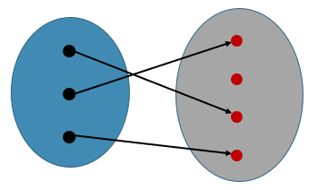
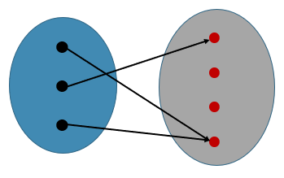
one-to-one
f is called one-to-one ⇔
x ≠ y ⇨ f(x) ≠ f(y) for all x, y
ASCII
$ → 36
@ → 64
A → 65
B → 66
C → 67
one-to-one
Not one-to-one

Slide 23
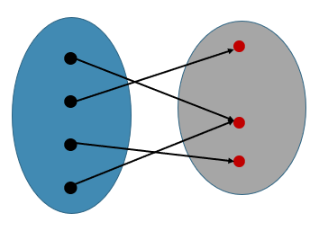
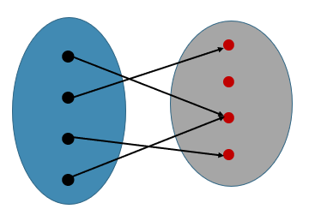
onto
a
b
c
d
1
2
3
a
b
c
d
1
2
3
4
f: A → B is onto if
f(A) = B
Onto
f(A) = {1, 2, 3} = B
Not onto
f(A) = {1, 3, 4} ≠ B

Slide 24
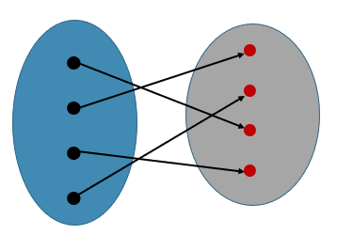
Bijection and inverse
ASCII
bijection inverse
$ → 36 $ ←36
@ → 64 @ ← 64
A → 65 A ← 65
B → 66 B ← 66
C → 67 C ← 67
bijection = 1-1 + onto

Slide 25
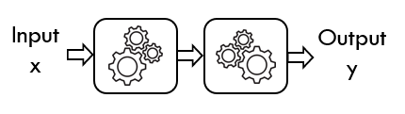

composite function
f
g
x ⇨ x + 3 ⇨ (x + 3)²
f(x) = ?
g(x) = ?
(g□f)(x) = ?
g□f

Slide 26
composite function
Given f = {(a, 2), (b, 1), (c, 2)}
g = {(1, a), (2, b), (3, c)}
Find g□f and f□g
a ⇨ 2 ⇨ b b ⇨ 1 ⇨ a c ⇨ 2 ⇨ b
g□f = {(a, b), (b, a), (c, b)}
1 ⇨ a ⇨ 2 2 ⇨ b ⇨ 1 3 ⇨ c ⇨ 2
f□g = {(1, 2), (2, 1), (3, 2)}

Slide 27
sequences
a₁, a₂, a₃, a₄, … sequence {a_{n}}
a[1], a[2], a[3], a[4], … array a[n]
Lucas numbers
n | 1 | 2 | 3 | 4 | 5 | …
a_{n} | 1 | 3 | 4 | 7 | 11 | …
What are the
next two terms?

Slide 28
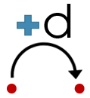
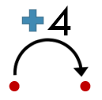
Arithmetic progression
Given the sequence 3, 7, 11, 15, 19, 23, 27, 31, …
Find the next two terms of the sequence
35, 39
What is the general term a_{n}, the n^{th} term?
a_{n} = 4n – 1

Slide 29
Formulae of sequences
1/ 5, 11, 17, 23, 29, 35, 41, …
a_{n} = 6n – 1
2/ 1, 3, 4, 7, 11, 18, 29, 47, …
L_{n} = L_{n-1} + L_{n-2} with L₁ = 1, L₂ = 3 // Lucas sequence
3/ 1, 7, 25, 79, 241, 727, 2185, ...
a_{n} = 3^{n} - 2

Slide 30

Recursive sequence
Given a₁ = 3, a₂ = 2, and a_{n} = 3a_{n-1} – a_{n-2} when n > 2
Find a₃, a₄, a₅.
n | 1 | 2 | 3 | 4 | 5
a_{n} | 3 | 2 | 3 | 7 | 18

Slide 31
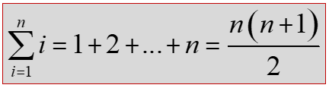
summations
s := 0
for i :=1 to n do
s := s + i
return(s)
read: the sum from i = m to i = n of a_{i}
return(n*(n+1)/2)

Slide 32



summations
Write each of these sums as sigma notation
1/ 1 + 3 + 5 + 7 + 9 + 11
2/ 3 + 3 + 3 + 3 + 3
3/ 1 + 4 + 7 + 10 + 13 + 16 + 19

Slide 33
summary
Sets
Functions
Sequences
Summations

Slide 34
THANKS

